Slide 1
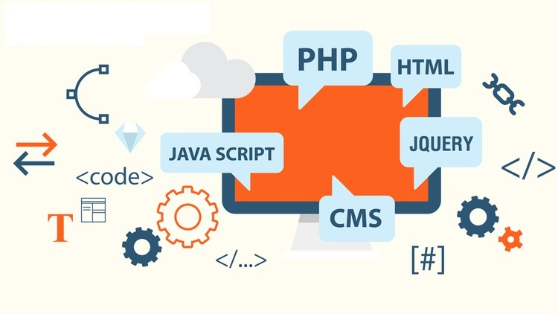
INTERNET PROGRAMMING &
Web Development

Slide 2

World Wide Web (WWW)
Informally people often use the terms "Internet" and "World Wide Web" (WWW) interchangeably, but this is inaccurate: the WWW is in fact just one of many services delivered over the Internet. Web uses internet to pass over the information.
WWW, is a system of interlinked, hypertext documents accessed through the Internet.
The web provides a communication platform for users to retrieve and exchange information over the internet.
Tim Berners-Lee, a British scientist, invented the WWW in 1989-1991, while working at CERN.
The Web was originally conceived and developed to meet the demand for automated information-sharing between scientists in universities and institutes around the world.

Slide 3
Brief History of WWW
The objective behind the invention of WWW was to merge the evolving technologies of computers, data networks and hypertext into a powerful and easy to use global information system.
In March 1989, Tim Berners-Lee, while working at CERN, took the initiative towards the invention of WWW and wrote the first proposal named “Information Management: A Proposal” to develop a distributed information system. He resubmitted a slightly edited version in May 1990.
In November 1990, Tim Berners-Lee, together with CERN colleague, Robert Cailliau, submitted a formal management proposal for ‘WorldWideWeb: Proposal for a HyperText Project’.

Slide 4
Brief History of WWW
By Christmas 1990, Berners-Lee had defined the Web’s basic concepts, that make it possible for users to locate and share information through the Internet.
HTML (Hyper Text Markup Language): The markup (formatting) language for the web.
HTTP (Hypertext Transfer Protocol): A set of rules for transferring data across the Web (between a server and a client).
URL (Uniform Resource Locator): A kind of “address” that is unique and used to identify each resource on the web.

Slide 5
Brief History of WWW
In 1990, he had written the first browser/editor (“WorldWideWeb.app”) and server software.
info.cern.ch was the address of the world's first web server, running on a NeXT computer at CERN.
By the end of 1990, the first web page was served on the open internet: http://info.cern.ch/hypertext/WWW/TheProject.html
The world's first web page address provided information about the World Wide Web project.
In 1991, people outside of CERN were invited to join this new web community.
On 30 April 1993, CERN issued a statement putting the Web into the public domain, ensuring that it would act as an open standard. The move had an immediate effect on the spread of the web.

Slide 6
Brief History of WWW
In 1993, a team at the University of Illinois’ National Center for Supercomputing Applications released Mosaic, the first Web browser to become popular with the general public.
The Web began to enter everyday use in 1993-4, when websites for general use started to become available
In 1994, Tim BL founded the World Wide Web Consortium (W3C), an organization that brings together representatives from many different technology companies to work together on the creation of web technology specifications. The aim was to standardize and develop the Web further.
By the end of 1994, the Web had 10,000 servers - of which 2000 were commercial - and 10 million users
The next few years saw the launch of websites such as Yahoo (1994), Amazon (1995), eBay (1995) and Google (1998).

Slide 7
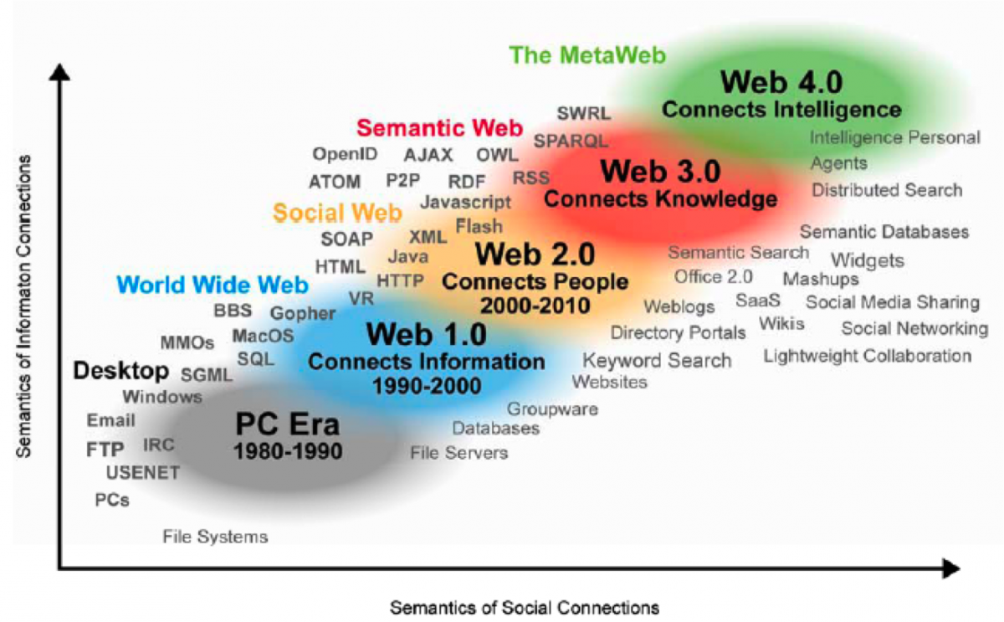
Evolution of WEB

Slide 8
Evolution of WEB
Web 1.0
The first version of web Web 1.0 also referred as Syntactic web or read only web is the era (1990–2000) where the role of a user is limited with consuming information provided by the content producers.
There is no option given for user or consumer to communicate back the information to the content producers.
During this early phase of web development, web pages were mostly static documents read from a server and displayed on a client, with no options for users to contribute content, or for content to be tailored to a user's specific demands.

Slide 9
Evolution of WEB
Web 2.0
The Web 2.0 also referred as Social Web or read-write web is the era (2000–2010 and continues even now) which facilitates interaction between web users and sites.
Previously a consumer of content provided by others, the web user has now become a prosumer, capable of adding information to a web page, and in this way communicating not only with the server, but through the server with other clients (users) as well.
These Web 2.0 technologies have made possible a wide range of social web sites now familiar to everyone, including chat rooms, blogs, wikis, product reviews and e-markets.
Some of the famous Web 2.0 applications are Facebook, Youtube, Flickr, Twitter etc.,

Slide 10
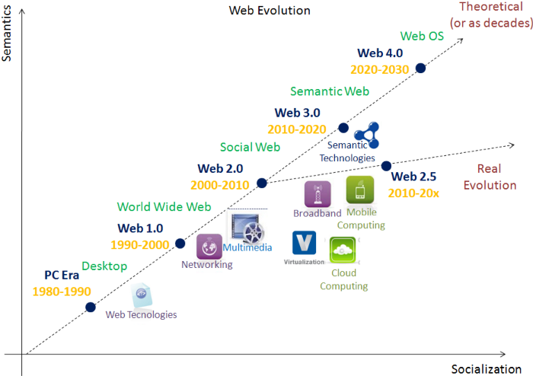
Evolution of WEB
Web 2.5
The Web 2.5 is the concept to address the practical and real evolution which we are currently seeing in our era 2010–2020 between Web 2.0 and 3.0.
Web 2.5 is majorly focusing on mobile computing and evolution in mobile technologies.
Some of the technologies which got introduced in this era are Progressive Web Apps(PWA), Accelerated Mobile Pages(AMP) etc.
To make in conceptually clear we can call Web 2.5 as the convergence between Social and Semantic web.
On our way to Web 3.0 some of player like Amazon, Google, etc., provides a service model in Cloud computing for developers to create web applications for their users to connect them on any devices, anytime and anywhere.

Slide 11
Evolution of WEB
Web 3.0
The Web 3.0 also referred as Semantic Web or read-write-execute is the era (2010 and above) which refers to the future of web.
In this era computers can interpret information like humans via Artificial Intelligence and Machine Learning. Which help to intelligently generate and distribute useful content tailored to a particular need of a user.
Some of the examples of web 3.0 are Apple’s Siri, Googles Cloud API, Wolfram Alpha.
What if computers can understand meaning behind information and what if they can learn “what we are interested in” ???
They can help us find what we want
They can recognize People, Place, Events, Companies, Product, Movies etc.,
They can understand the relationship between things

Slide 12
How WWW Works?
The web works on a "client-server model".
Client-server architecture is an architecture of a computer network in which many clients (remote processors) request and receive service from a centralized server (host computer)
Clients are the typical web user's internet-connected devices and web-accessing software available on those devices. Client is capable of receiving information or using a particular service from the service providers (Servers).
Server is a remote computer which provides information (data) or access to particular services. It stores webpages, sites, or apps. When a client device wants to access a webpage, a copy of the webpage is downloaded from the server onto the client machine to be displayed in the user's web browser.

Slide 13
How WWW Works?
Following steps explains how the web works:
User enters the URL of the web page in the address bar of web browser.
The client, which is your computer, more specifically the browser you are using, sends a request to the Domain Name Server for the corresponding IP address.
After receiving IP address, browser sends the request for web page to the web server using HTTP protocol which specifies the way the browser and web server communicates.
Then web server receives request using HTTP protocol and checks if the page exists, if it exists the server will send the HTML page in response
Now the web browser receives the web page. It interprets it and display the contents of web page in web browser’s window.
If the requested page doesn’t exists then the server sends a 404 Error code which means the web page doesn’t exist on the server.

Slide 14
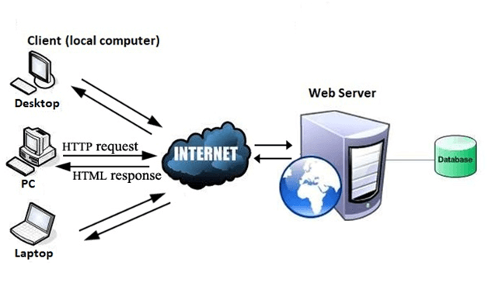
How WWW Works?
An important disadvantage of the client-server model is that if too many clients simultaneously request data from the server, it may get overloaded. In addition to causing network congestion, too many requests may result in a denial of service.
An important advantage of the client-server model is that its centralized architecture helps make it easier to protect data with access controls that are enforced by security policies.

Slide 15





Client-Side VS Server-Side
Programming
Frontend Runs on the user computer |  | Backend Runs on the server
Interfacing Collection of user input, interfacing with the server |  | Processing Process es data, doing transactions, and complex computetion
Fully Visible Scripts can beviewed by the user |  | Invisible Scripts are not open to users.
Less Secure Generally less secure as users can see and mess with the scripts |  | More Secure Alot more secure as users don’t see the source code, and they usually can not interrupt the process.
HTML, CSS, JavaScript, VBScript |  | PHP, ASP, Phyton, Ruby, C#, Java

Slide 16
Front End & Back End Development
How website looks..
How website works..
The main difference between front and back end development is the particular area of focus.
The front end is concerned with a website’s appearance, look and feel; while the back end focuses on functionality on a website’s server-side, including all communications between the browser and the database.
To build a website, a front end developer takes care of the theme, including the presentation, images and style.
The back end developer takes care of the database, security, site performance and users.
Each side needs to communicate and operate effectively with the other as a single unit to improve the website’s functionality.

Slide 17
Front End Development
The part of a website that user interacts with directly is termed as front end.
It is also referred to as the ‘client side’ of the application.
It includes everything that users experience directly:
colors and styles,
images,
graphs and tables,
buttons,
navigation menu and etc.

Slide 18
Front End Development
The structure, design, behavior, and content of everything seen on browser screen when websites, web applications, or mobile apps are opened up, is implemented by front end developers.
Responsiveness and performance are two main objectives of the front end.
The developer must ensure that the site is responsive i.e. it appears correctly on devices of all sizes no part of the website should behave abnormally irrespective of the size of the screen.

Slide 19
Front End Development
Front End Languages
HTML
CSS
JavaScript
VBScript
Front End Frameworks and Libraries
AngularJS
React.js
Bootstrap
jQuery
SASS

Slide 20
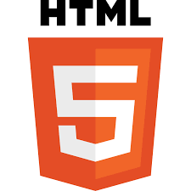
Front End Development
Languages
HTML
HTML stands for Hyper Text Markup Language.
It is used for creating websites and web applications for World Wide Web.
HTML5 is the latest and most enhanced version of HTML.
HTML5 is a standard language for structuring and presenting content on the WWW.
Any page made in HTML5 is compatible with both computers and mobile devices. In other words, you can set the mobile specification from the HTML document itself.
All the latest versions of web browsers including the mobile web browsers that come pre-installed on iPhones, iPads, and Android phones have excellent support for HTML5.

Slide 21
Front End Development
Languages
CSS (Cascading Style Sheets)
CSS is a simply designed language intended to simplify the process of making web pages presentable.
CSS is a language that that lets you describe how the elements defined in your HTML should be styled, allowing changes in font, color, layout, simple animations, and other superficial elements.
It is used for defining the look and feel of a webpage
More importantly, CSS enables you to do this independent of the HTML that makes up each web page.
CSS3 is the most widely used version, though CSS4 has been released

Slide 22
Front End Development
Languages
JavaScript
Developed by Netscape, it is good for network-centric web applications.
It is a famous scripting language used to create the magic on the sites to make the site interactive for the user.
It is used to enhancing the functionality of a website by running cool games and displaying timely content updates, interactive maps, animated 2D/3D graphics, scrolling video jukeboxes, etc.
JavaScript can calculate, manipulate and validate data.
With the breakthroughs of Node.js and AngularJS, JavaScript became the undisputed frontrunner in-browser programming today
Most web developers use JavaScript for client-side scripting in order to be sure their website works in all browsers.

Slide 23
Front End Development
Languages
JavaScript
The merits of using JavaScript are:
Less server interaction − You can validate user input before sending the page off to the server. This saves server traffic, which means less load on your server.
Immediate feedback to the visitors − They don't have to wait for a page reload to see if they have forgotten to enter something.
Increased interactivity − You can create interfaces that react to user-initiated events such as button clicks, link navigation.
Richer interfaces − You can use JavaScript to include such items as drag-and-drop components and sliders to give a Rich Interface to your site visitors.

Slide 24
Front End Development
Languages
VBScript
"Microsoft Visual Basic Scripting Edition"
It is developed and maintained by Microsoft for the purpose of developing dynamic web applications.
It is a lightweight active scripting language modeled on Visual basic.
The syntax of VBScript is very similar to that of Visual Basic.
It gives different functionalities to the web pages and designs the user interaction in a different manner.
VBScript only worked in Internet Explorer while JavaScript was a cross-browser solution that also worked in other browsers.
It is not supported by their competitors' browsers such as Firefox and Opera.
Unfortunately, VBScript is now disabled by default in Internet Explorer on all supported versions of Windows after a recent Windows update.
That’s a big reason why JavaScript won!

Slide 25
Front End Development
Frameworks and Libraries
AngularJS
AngularJs is a JavaScript open source front-end framework that is mainly used to develop single page web applications (SPAs).
It is a continuously growing and expanding framework which provides better ways for developing web applications.
It changes the static HTML to dynamic HTML. It is an open source project which can be freely .
It extends HTML attributes with Directives.

Slide 26
Front End Development
Frameworks and Libraries
React.js
React is a declarative, efficient, and flexible JavaScript library for building user interfaces.
ReactJS is an open-source, component-based front end library responsible only for the view layer of the application.
Bootstrap
Bootstrap is a free and open-source tool collection for creating responsive websites and web applications.
It is the most popular HTML, CSS, and JavaScript framework for developing responsive, mobile-first web sites.

Slide 27
Front End Development
Frameworks and Libraries
jQuery
jQuery is an open source JavaScript library that simplifies the interactions between an HTML/CSS document, or more precisely the Document Object Model (DOM), and JavaScript.
Jquery is a javascript toolkit that simplifies writing code and enables rapid web development.
The claim of the developers is that jquery runs exactly the same across all brow
Elaborating the terms, jQuery simplifies HTML document traversing and manipulation, browser event handling, DOM animations, Ajax interactions, and cross-browser JavaScript development.
SAS
It is the most reliable, mature and robust CSS extension language.
It is used to extend the functionality of an existing CSS of a site including everything from variables, inheritance, and nesting with ease.

Slide 28
Back End Development
Backend is the server side of the website.
It is the part of the website that you cannot see and directly interact with.
The parts and characteristics developed by backend designers are indirectly accessed by users through a front-end application.
It stores and arranges data, and also makes sure everything on the client-side of the website works fine.
Activities, like writing APIs, creating libraries, and working with system components without user interfaces or even systems of scientific programming, are also included in the backend.

Slide 29
Back End Development
Server-side programming must deal with dynamic content. Most web pages are not static since they deal with searching databases.
Server-side Uses
It processes the user input
Displays the requested pages
Interaction with servers/storages
Interaction with databases
Querying the database
Encoding of data into HTML
Operations over databases like delete, update.

Slide 30
Back End Development
Languages & Frameworks
PHP
It is an open source, server-side scripting language designed specifically for web development.
Since PHP code executed on the server side so it is called server-side scripting language.
It has been used to create web applications for over 35 years, with multiple frameworks being available for the developers.
Wordpress runs on it and powers 25% of the websites today, including most popular blogs and news websites.
It finds applications mainly in the fields of server-side and standalone web application development along with the development of CMS systems.
<!DOCTYPE html>
<html>
<head>
<title> PHP Time</title>
</head>
<body>
<h1>Welcome</h1>
<?php $t = date("H");
if ($t < 12) { echo '<p>Good morning!</p>'; } else {
echo '<p>Good day!</p>'; } ?>
</body>
</html>
Notable websites built on PHP: Facebook, Wikipedia, Wordpress.

Slide 31
Back End Development
Languages & Frameworks
ASP.NET
ASP.NET is an open-source, server-side web-application framework designed for web development to produce dynamic web pages.
It was developed by Microsoft to allow programmers to build dynamic web sites, applications and services.
Prior to ASP.NET, Microsoft had developed another server-side scripting language with the name ASP (Active Server Pages) which was used widely on the web. However, other than the name, ASP and ASP.NET are very different technologies.
.NET is a developer platform made up of tools, programming languages, and libraries for building many different types of applications.
The base platform provides components that apply to all different types of apps. Additional frameworks, such as ASP.NET, extend .NET with components for building specific types of apps.

Slide 32
Back End Development
Languages & Frameworks
Java
Java was developed in an effort to create a simple, object-oriented interpreted programming language.
It was released in 1995 and quickly became the hottest new programming language due in part to its promise of "write once, run anywhere".
It was to act as an alternative to C++ which was widely used in business applications of the 90s.
But over time, Java far surpassed C++ in terms of popularity due to its lower learning barrier and the highly distributable nature of Java code.
It is powerful in terms of scalability and it’s components are easily available.
Java, with the help of the Java Virtual Machine, is a language that is independent of platforms. This makes it the most popular programming language for enterprises.

Slide 33
Back End Development
Languages & Frameworks
Java
Spring is one of the most popular frameworks for Java web applications and is usually considered essential in a Java web developer's toolbox.
However, development with Java can be overengineering, and development time can take considerably longer than other languages
It is prevalent for large-scale applications, but you should consider other programming languages for smaller applications.
Hello World code snippet in Java:
public class HelloWorld
{
public static void main(String[ ] args)
{
System.out.println("Hello World");
}
}
Java is widely used in the fields of application development, Big data, and web development.
Notable websites built on Java: Google, Amazon, eBay.

Slide 34
Back End Development
Languages & Frameworks
Python
Python is an interpreted, high-level and general-purpose programming language.
It was designed to be simple and easy to learn. Hence reducing the overall development time of the project code.
Lets you work quickly and integrate systems more efficiently.
Its ease of coding, and support from the open-source community has led to the exponential growth of Python
Used by both beginners and as well as experienced programmers
It has a set of different libraries and APIs that support data analysis, data visualization, and data manipulation.

Slide 35
Back End Development
Languages & Frameworks
Python
It is also one of the most popular languages that can handle complex scientific calculations and used for statistical analysis.
Flask is a popular micro-framework for Python to create web applications. It's a small framework that provides you with the necessary features to get started with developing your web application. Another popular framework is Django.
from flask import Flask
app = Flask(__name__)
@app.route("/")
def hello():
return "Hello World!"
if __name__ == "__main__":
app.run()
Notable websites built on Python: Youtube, Instagram, Dropbox, Quora.

Slide 36
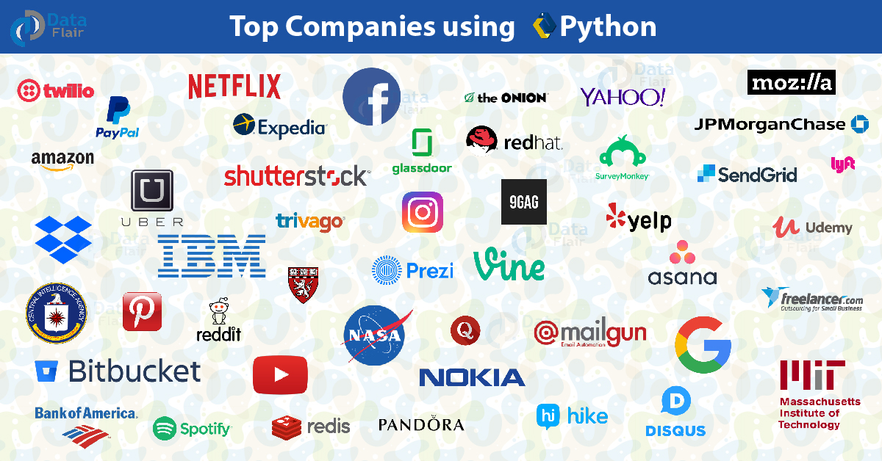
Back End Development
Languages & Frameworks
Python

Slide 37
Back End Development
Languages & Frameworks
Ruby
Ruby started as an object-oriented scripting language. But over time, it grew into an interpreted high-level general-purpose programming language and started to become popular at 2010s.
It combines some of the best features of all popular programming languages. It is dynamic, functional and concise.
Mostly popular for small applications as it is suitable for rapid web development.
Rails is the most popular framework to use with Ruby. A micro framework Sinatra can be better for beginners
Ruby is widely used in the field of web development, data analysis and AI development.
#!/usr/bin/env ruby
require 'sinatra'
get '/' do
redirect to('/hello/World')
end
get '/hello/:name' do
"Hello #{params[:name]}!"
end

Slide 38
Back End Development
Languages & Frameworks
C#
Microsoft developed C# as a C-like programming language with object-oriented features. This was part of their .NET project.
Initially, the language was seen as a copy of Java. However, future developments brought a clear, distinct identity to C#.
C# offers a great developer experience. With Microsoft’s backing and presence of over two decades, it has numerous libraries and frameworks.
Further, it is a platform-independent programming language.
C# is widely used in the fields of system programming, game development, web development and app development.
Hello World code snippet in C#:
namespace HelloWorld
{
class Hello
{
static void Main(string[ ] args)
{
Console.WriteLine("Hello World");
}
}
}

Slide 39
Back End Development
Languages & Frameworks
Node.js
Node.js (released in 2009) is an open source and cross-platform runtime environment for executing JavaScript code outside of a browser.
You need to remember that Node.js is not a framework and it’s not a programming language. Most of the people are confused and understand it’s a framework or a programming language.
It provides the ability to run JavaScript code on server-side. Those who are already familiar with JaveScript do not have to learn anything new since the same coding can be used for both front-end and back-end.
You can use JavaScript for front-end rendering and then reuse it later in the back-end, which is one of the key benefits to writing JavaScript.

Slide 40
Back End Development
Languages & Frameworks
Node.js
This language is mostly beneficial if applications are used in real-time such as chats and online games
Node.js mostly used for building back-end services like APIs, Web Applicaitons or Mobile Applications.
It uses Express framework for web application development.
It’s used in production by large companies such as Paypal, Uber, Netflix, LinkedIn, Netflix, Wallmart and etc.

Slide 41
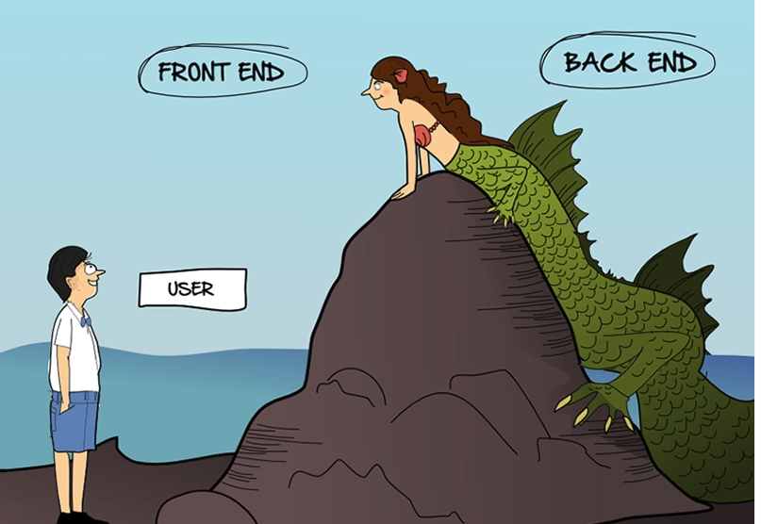
Frontend VS Backend Development

Slide 42
Other Important Concepts in Web Development
Cross-browser Compatibility
It is the practice of trying to make sure your webpage works across as many devices as possible.
This includes using technologies that all the browsers support, delivering better experiences to browsers that can handle them (progressive enhancement), and/or writing code so that it falls back to a simpler but still usable experience in older browsers.
It also involves a lot of testing to see if anything fails in certain browsers, and then more work to fix those failures.
Responsive Web Design
Responsive web design is the practice of making your website functionality and layouts flexible so they can automatically adapt to different browsers.
An obvious example is a website that is laid out one way in a widescreen browser on the desktop, but displays as a more compact, single-column layout on mobile phone browsers.

Slide 43
Other Important Concepts in Web Development
Performance
It means getting web sites to load as quickly as possible, but also making them intuitive and easy to use so that users don't get frustrated and go somewhere else.
Accessibility
It means making your websites usable by as many different kinds of people as possible (related concepts are diversity and inclusion, and inclusive design).
This includes people with visual impairments, hearing impairments, cognitive disabilities, or physical disabilities.
It also goes beyond people with disabilities — how about young or old people, people from different cultures, people using mobile devices, or people with unreliable or slow network connections?

Slide 44
Other Important Concepts in Web Development
Internationalization
Means making websites usable by people from different cultures, who speak different languages to your own.
There are technical considerations here (such as altering your layout so that it still works OK for right-to-left, or even vertical languages), and human ones (such as using simple, non-slang language so that people who have your language as their second or third language are more likely to understand your text).
Privacy & Security
These two concepts are related but different.
Privacy refers to allowing people to go about their business privately and not spying on them or collecting more of their data than you absolutely need to.
Security refers to constructing your website in a secure way so that malicious users cannot steal information contained on it from you or your users.

Slide 45
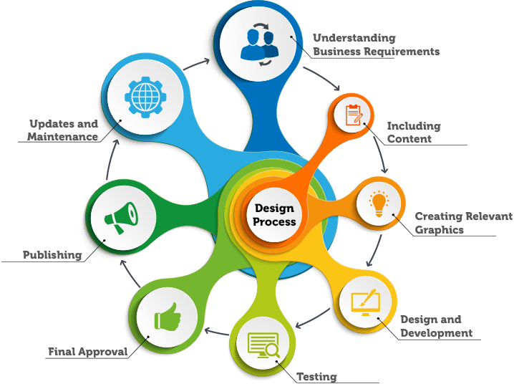
Website Development Process

Slide 46

Thank you for listening..
Any Questions?

